Slide 1


Control de Calidad en Radioterapia
Jose Eduardo Villarreal-Barajas Ph.D., DABR, FCCPM

Slide 2
Temas
1. Perspectiva histórica del CCR
a. La evolución del CCR: Calidad y Seguridad
b. Revisión de los protocolos de CCR: Una perspectiva canadiense
2. Control de calidad de unidades de terapia superficial (75kVp – 300 kVp)
a. Control de calidad de los equipos de rayos X
b. Control de calidad del sistema de cálculo de dosis
3. Control de Calidad de unidades de Radioterapia/Co-60
a. Control de calidad de unidades de Co-60
b. Control de calidad del sistema de cálculo de dosis
4. Control de calidad de aceleradores lineales en radioterapia
a. Control de calidad del acelerador lineal y sus componentes principales
b. Control de calidad del sistema de cálculo de dosis para aceleradores lineales

Slide 3
5. Control de calidad de sistemas de planeación (3D)
a. Control de calidad en sistemas de planeación-3D (Rayos X y haces de Electrones)
b. IMRT
6. Nuevas tendencias en el Control de Calidad en Radioterapia
a. FEMA (Failure Mode and Effects Analysis) y su uso como herramienta para el desarrollo de un programa efectivo de Garantía de Calidad en Radioterapia
    b. Control “objetivo” de calidad en radioterapia

Slide 4
Tema 1
Perspectiva histórica del CCR
La evolución del CCR: Calidad y Seguridad
Revisión de los protocolos de CCR: Una perspectiva canadiense

Slide 5

Definitions
Quality Assurance:
All those planned and systematic actions necessary to provide adequate confidence that a product or service fulfills requirements for quality
Quality Control:
The operational techniques that are used to fulfill requirements for quality
Quality and Safety in Radiotherapy, eds T. Pawlicki et al. Taylor and Francis, New York, 1-6 (2010)

Slide 6
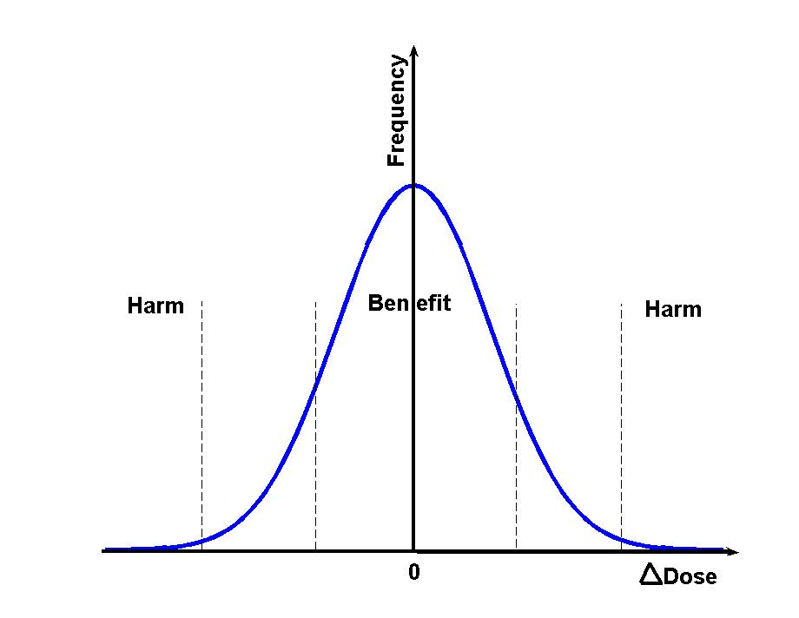
Quality Assurance, Control and Improvement
Quality Control: operational techniques to maintain central peak width.
Quality Assurance: planned and systematic actions to maintain central peak width.
Quality Improvement: actions to reduce the central peak width.
Deviation from optimum dose

Slide 7
A bit of History
1895 Wilhelm Konrad Roentgen discovers X-rays.
1896 Concerns first raised about possible injuries from X-ray exposures .
1899 First malpractice lawsuit award for X-ray burns
1901 X-rays are shown to be lethal to mammals
1903 George Perthes discovers that X-rays can inhibit the growth of tumors
1904 First human death for X- rays reported
1910 X-rays used to diagnose disorders of the digestive tract
1911 First reports linking X-rays with leukemia and cancer in physicians published .
1920 First X-ray protection committee formed by the American Roentgen Ray Society.
…………………………………………….
1924 First radiation tolerance dose proposed by Arthur Mutscheller for use as a guide to limiting exposure of an individual to radiation.

Slide 8
500 mSv / exp.
50 R / exp.
1 mSv / day
ICRP 26
0.1 R / day
ICRP 60
50 mSv
20 mSv

Slide 9
QC in radiotherapy – The Past
From 1986 to late 1920’s
  short-term (skin burns and epilation) and longer-term (cancer induction)
  In 1928 the roentgen was defined as a unit of exposure
  ⁶⁰Co teletherapy in the 1950’s
  Physicians lost the ability to judge the response to treatment by watching for reactions in the patient’s skin
  Physicists became an essential part of the clinical practice of radiation therapy
  1970’s Linear Accelerators start replacing Co-60
  The calibration process includes interpretation of radiation treatments delivered as a number of “monitor units”

Slide 10

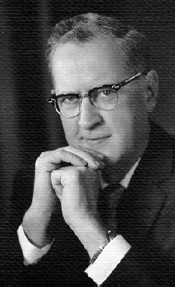

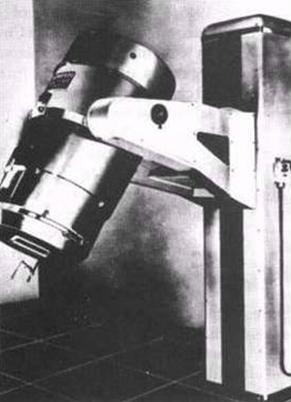
Co-60 Therapy
Harold Johns 1915-1998
1500 Ci of Co-60
Source was contained on 3 x 5.5 cm cylinder
First Patient treated with the Co-60 unit was cured of her cancer and lived into her 90’s
Half of C0-60 units in the world are made in Canada
Cure rate for cervical cancer went from 25 %to 75 %
Saskatchewan’s 1st Cobalt-60 Unit

Slide 11
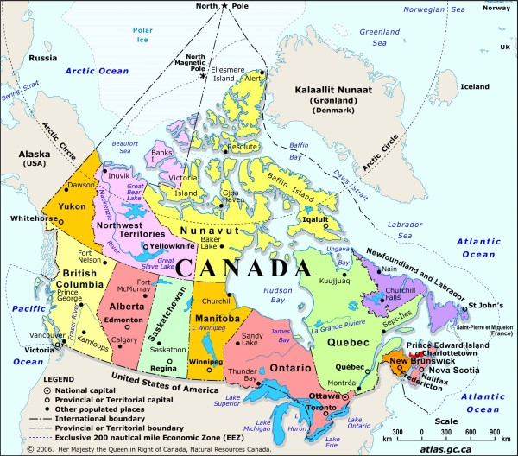

Slide 12
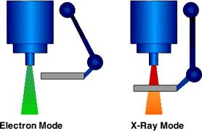
The Therac-25 accidents
Six patients received ~20 000cGy, 2 died (1985-1987)
The most serious computer-related accidents to date
The Therac-25 software had more responsibility for maintaining safety than the software in the previous machines
In March 1983, AECL performed a safety analysis on the Therac-25. This analysis was in the form of a fault tree and apparently excluded the software.
XII Mexican Symposium on Medical Physics, HARAO, Oaxaca Mexico, 16-18 Marzo 2012

Slide 13
QC in radiotherapy - The Present
Medical physicists are fully integrated to the radiation therapy team
  Certification (ABR, CCPM, etc)
  Maintenance of Certification
  2014 Commission on Accreditation of Medical Physics Educational Programs (CAMPEP) restricted certification
  Reduced costs and higher quality must be the goal, not reduced costs and lower quality
  The forces for change are originating principally outside the medical physics profession
  Rapid change in Technology require on going training

Slide 14
In Canada
Canadian Partnership for Quality Radiotherapy
Canadian Association of Radiation Oncology
Canadian Organization of Medical Physicists
Canadian Association of Medical Radiation Technologists
Canadian Partnership Against Cancer.

Slide 15
CPQR supports:
The universal availability of high quality and safe radiotherapy for all Canadians through the development of consensus-based guidance and indicator documents to aid in radiation treatment program development and evaluation.
Notes:
The formation of this committee, and more importantly, the work that the committee has already done, has the potential of having a very significant effect on the provision of quality Radiotherapy in Canada.

Slide 16
Standards for Quality Control Guidelines
at Canadian Radiation Treatment Centres
Source materials developed from 1989 to the present
Guidelines documents produced by qualify Medical Physicists
Guidelines docs. are open for comments for a period of 2 months
Once the comments are reviewed, guidelines are field tested
The feedback form the field testing are incorporated in the guidelines final document

Slide 17
Standards for Quality Control at
Canadian Radiation Treatment Centres
Approved Documents (under revision)
Electronic Portal Imaging Devices
Conventional Radiotherapy Simulators
Kilovoltage X-ray Radiotherapy Machines
Medical Linear Accelerators
Cobalt Therapy Units
Multileaf Collimators
Stereotactic Radiosurgery/Radiotherapy
Brachytherapy Remote Afterloaders
CT Simulators
LDR Prostate Brachytherapy
Major Dosimetry Equipment
Treatment Planning Systems
Documents under review
Linac Integrated kV Imaging Systems and CBCT Simulators
Radiation Therapy Data Management Systems
Physics Plan Review
2005-2007
2011-2012

Slide 18
QC performance standards*
Performance standards are stated in terms of tolerance & action levels
Tolerance levels are considered not to compromise treatment quality
Action levels require an intervention
* P. Dunscombe, C. Arsenault, JP. Bissonnette, et. al. "The development of quality control standards for radiation therapy equipment in Canada," J. Appl. Clin. Med. Phys 8, 108-118 (2007)
Notes:
18
The performance standards of study are those promulgated by the Canadian Association of Provincial Cancer Agencies (CAPCA)
In theses series of documents, performance standards of those parameters that can be measured are stated in terms of tolerance and action levels as illustrated in the figure
According to CAPCA performance dev that fall within Tolerance levels …
Whereas performance dev that fall beyond action levels… of a physicist or service personnel to bring the system back to an acceptable level of performance.
We examined the effects of deviations in 9 key performance characteristics from a dosimetric perspective.

Slide 19
Audit of Compliance with Canadian Standards
Dr. Brenda Clark, Interactions 53 (2009) 99

Slide 20
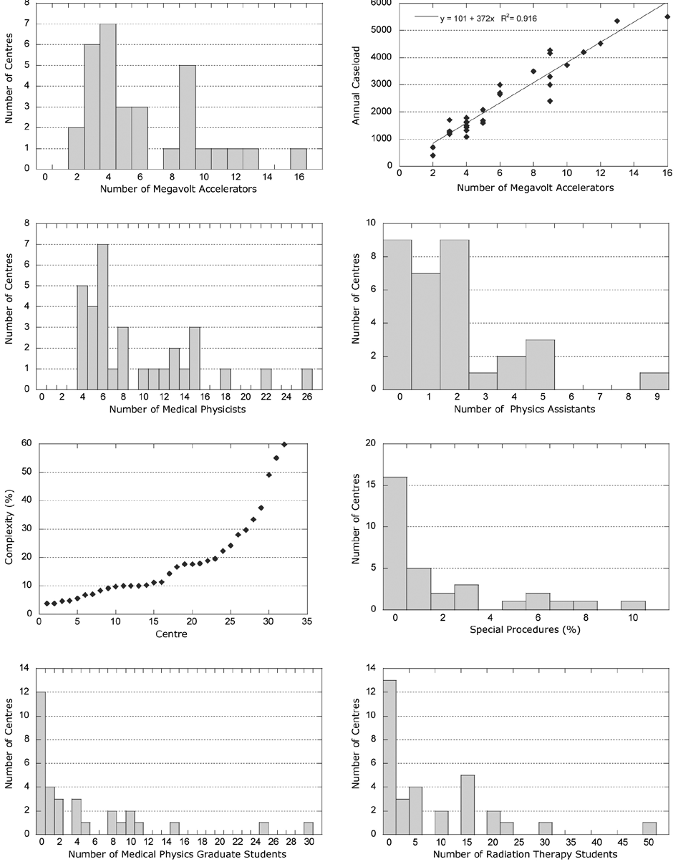

Slide 21
QC in radiotherapy - The Future
Conformal Radiation Therapy minimum standard
IMRT continues its expansion
VMAT will prove its capabilities
IGRT will become the standard of care (PET/CT, SPECT/CT, PET/MRI etc)
Hypofractionation will continue to expand
Soft tissue visualization to generate new Tx modalities /Linac-MR
Molecular Imaging will have a more active role in RT
Nanoparticles for enhance RT
Proton and Ion therapy will continue to expand
Quantifying variations in radiosensitivity throughout the tumor and patients
Lots of opportunities-jobs for Medical Physicists

Slide 22

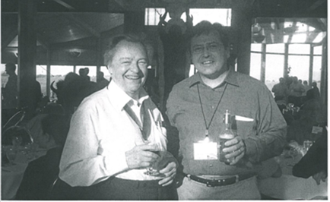
..and now my book is legal!

Slide 23
Tema 2
Control de calidad de unidades de terapia superficial (75kVp – 300 kVp)
Control de calidad de los equipos de rayos X
Control de calidad del sistema de cálculo de dosis

Slide 24
Orthovoltage X ray Therapy Machines

Slide 25
Daily Tests
DK1 Functional check of the operability of patient monitoring audio-visual devices.
DK2 Functional check of the operability of door-closing mechanisms and interlock(s).
DK3 Functional check of couch motion and brakes (where applicable)
DK4 Functional check of unit motions and motion stops
DK5 Functional check of interlocks for added filters, correct placement of filters and the matching of filters with kV value.
DK6 Functional check of the beam status indicators.
DK7 Functional check of beam-off at key-off
DK8 Functional check of emergency off button
DK9 Functional check of kV and mA indicators
DK10 Quantitative verification of correct operation of back-up timer
DK11 Quantitative dosimetric test: output reproducibility test at the chosen
energy and filter combinations.

Slide 26
Kilovoltage X ray Therapy Machines – Monthly
Tolerance and Action Levels are specified in millimeters unless otherwise stated

Slide 27
Monthly Tests
MK1 Verification that the unit and accessories are firmly anchored and may be used without endangering patients or staff.
MK2 Verification of the integrity of the cones and cone indicators.
MK3 Verification of the distance indicator.
MK4 Verification the angle readouts
MK5 Performance parameters refer to agreement at each edge. (This test does not apply to all machine designs).
MK6 Geometric test to verify the light field sizes (where applicable)
MK7 Confirmation of radiation field size at least two field sizes must be checked.

Slide 28
MK8 Using a film, the flatness and symmetry of the X-ray beam must be
assessed for the largest cone.
MK9 Timer and end-effect error measurement may be performed in conjunction with MK10.
MK10 Output linearity measurement for a standard SSD and field size and a dose range of 10-1000cGy.
MK11 Output reproducibility verification with the criterion being specified as the coefficient of variation of 10 readings under the same exposure conditions.
MK12 The Half Value Layer of any clinically used beams is measured. The HVLs measured in mm Al or Cu as appropriate are compared with the values obtained at commissioning. These tolerances acknowledge measurement uncertainty.

Slide 29
Annual Tests
Tolerance and Action Levels are specified in millimeters unless otherwise stated

Slide 30
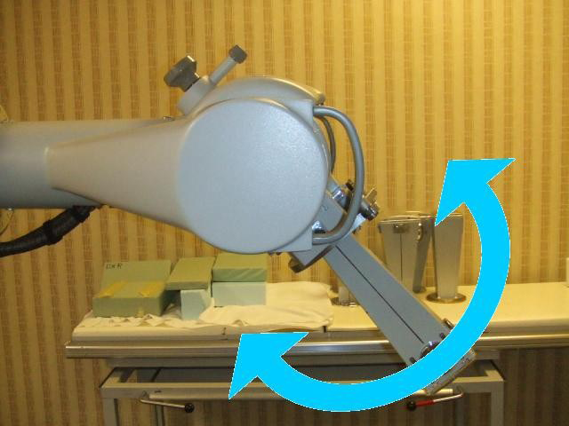
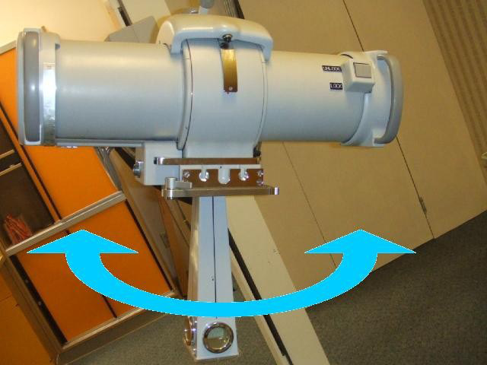
Unexpected output variation
Head tilt
Head rotation
Mehran Goharian, Ian Nygren, Mauro Tambasco, Jose Eduardo Villarreal Barajas, Angular dependence of the output of a kilovoltage X-ray therapy unit, JACMP 11(3), 2010. p276-280

Slide 31
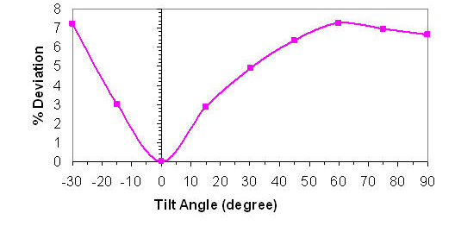

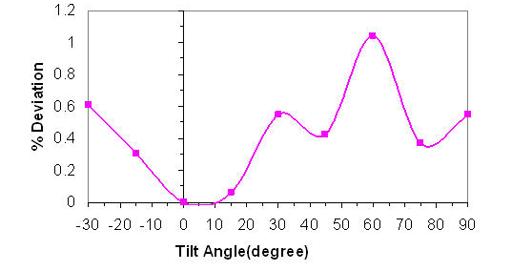
75 kVp
Output
Head tilt
225 kVp

Slide 32
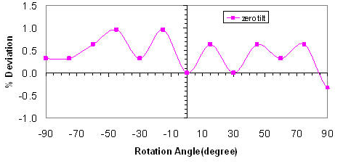

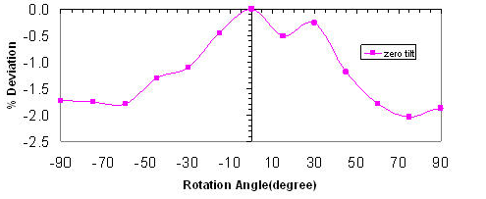
Output
Head rotation

Slide 33
Orthovoltage X ray Therapy Machines – Monthly
Draft 2012

Slide 34
Tema 2
Control de calidad de unidades de terapia superficial (75kVp – 300 kVp)
Control de calidad de los equipos de rayos X
Control de calidad del sistema de cálculo de dosis

Slide 35
TG61
AAPM protocol for 40–300 kV x-ray beam dosimetry
in radiotherapy and radiobiology
Med. Phys. 28 (6), June 2001

Slide 36
Orthovoltage time/dose calculations

Slide 37
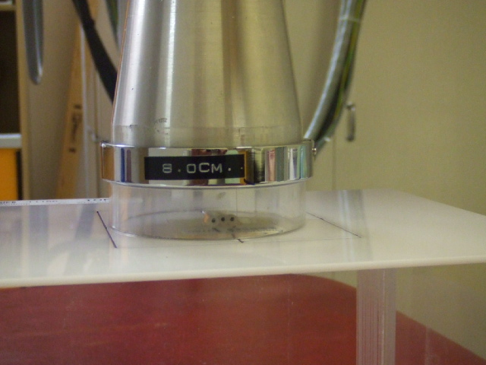
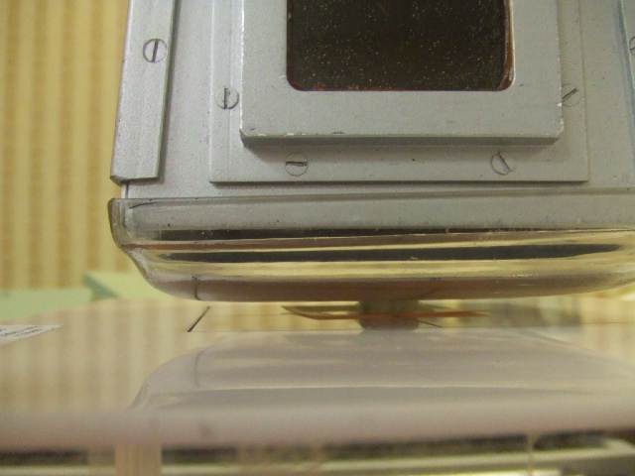
RPC TLDs irradiation setup
75 kVp
225 kVp

Slide 38
The Ottawa Orthovoltage Incident

Slide 39
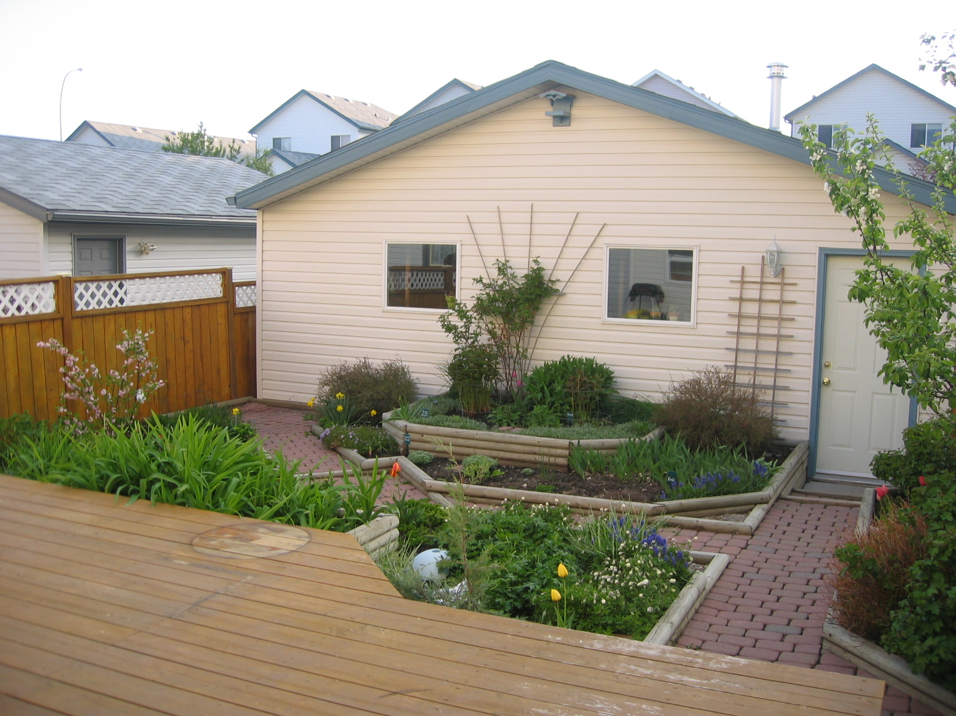

Slide 40
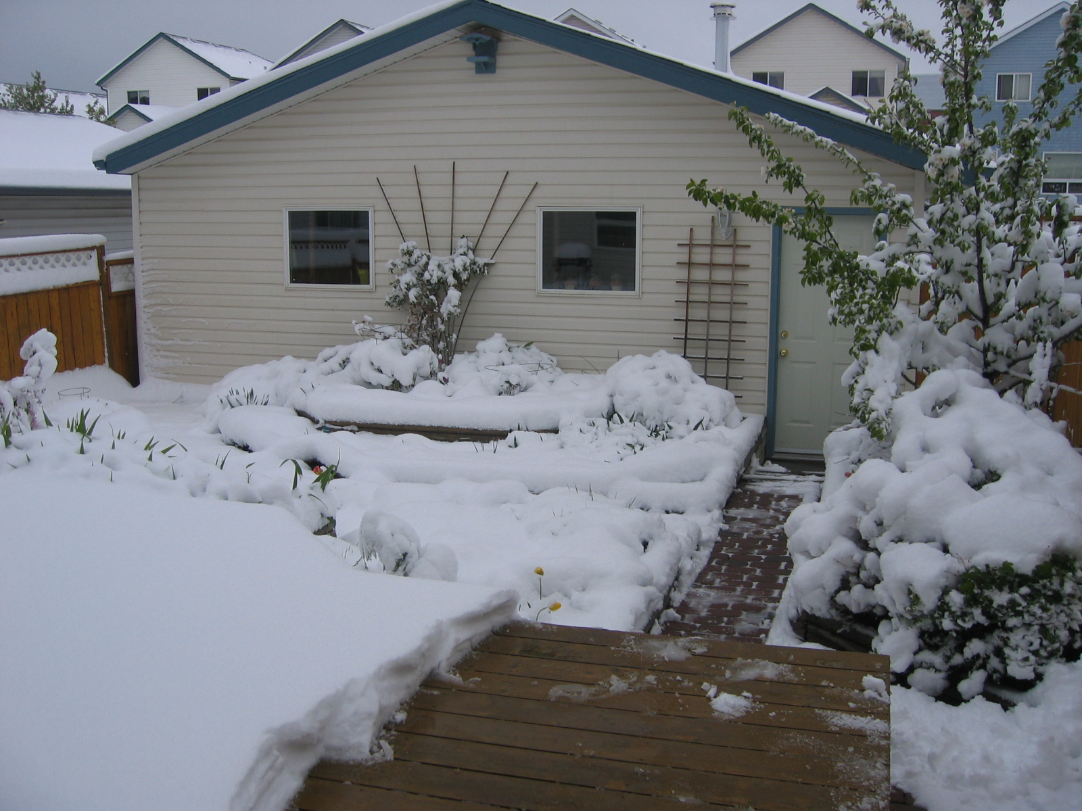

Slide 43
Tema 3
Control de Calidad de unidades de Radioterapia/Co-60
Control de calidad de unidades de Co-60
Control de calidad del sistema de cálculo de dosis

Slide 44
Co-60
Tolerance and Action Levels are specified in millimeters unless otherwise stated

Slide 45
Daily Tests
DCO1-9
The configuration of these tests will depend on the design of the facility and equipment. Safety is the concern and tests should be designed accordingly. As a minimum, manufacturer’s recommendations and applicable regulations must be followed.
DCO10
Alignment of crosswires and appropriate lasers for collimator angle 0º, gantry angles 0º, 90º and 270º at an SSD of SAD – 10cm.
DCO11
Gantry angle 0º and an SSD of SAD – 10cm.
DCO12
Gantry angle 0º and an SSD of SAD+10cm
DCO13
Gantry angle 0º, nominal SAD, field sizes of 10x10 and 20x20 cm²

Slide 46
Co-60
Tolerance and Action Levels are specified in millimeters unless otherwise stated

Slide 47
Monthly Tests
MCO1-2
Proper functioning of the accessories and indicators
MCO3
Mechanical and digital gantry angle readouts must be verified using a spirit level, or other appropriate leveling device, for at least 0º, 90º, 180ºand 270º
MCO4
Mechanical and digital collimator angle readouts must be verified using a spirit level, or other appropriate leveling device, for at least 0º, 90º and 270º.
MCO5
Mechanical and digital couch position readouts must be verified over an appropriate clinical range in the directions of the three cardinal axes.

Slide 48
Monthly Tests
MCO6
Rotation of the couch about the optical collimator rotation axis must be verified
MCO7
The couch rotation angle must be verified over an appropriate clinical range.
MCO8
A mechanical device, calibrated against the true radiation isocentre, is used to provide the base reading for the check of the optical distance indicator. The standards stated in the Table apply at the isocentre. The optical distance indicator should be checked over a clinically relevant range of SSD and gantry angle. The tolerance and action level may be twice as large (i.e. 2 and 4 mm) at the clinical limits of the optical distance indicator’s range.

Slide 49
Monthly Tests
MCO9
The trajectory of the optical image of the crosswires is measured at the appropriate SSD for collimator angles of 0º, 90o and 270º. Tolerances and Action Levels refer to the diameter of the optical isocentre so measured.
MCO10
Geometric alignment of the radiation and optical field edges must be established over a range of field sizes at gantry angles 0º, 90º and 270º.
Representative half blocked fields must be included if available. A minimum of six field sizes will b e required for this test. Tolerances and Action Levels apply to each edge of a rectangular field.
MCO11
Compliance of the radiation and optical field sizes with the indicated dimensions must be established over a range of field sizes at gantry angles 0º, 90º and 270º. Representative half blocked fields must be included if available. A minimum of six field sizes will be required for this test.

Slide 50
Monthly Tests
MCO12
Although the radiation output (cGy/min) from a Co-60 unit should decay at a known rate, it is necessary to confirm this regularly to ensure that no unexpected changes have occurred (e.g. malfunction of shutter or source transport mechanism).
MCO13
From a series of radiation measurements with different set times, the timer offset or shutter error is determined.
MCO14
Film and optical densitometry is used to confirm symmetry of the radiation output and hence proper centering of the source with respect to the primary collimator. A large field, e.g. 30x30cm², should be used.

Slide 51
Monthly Tests
MCO15
Documentation relating to the daily quality control checks, preventive maintenance, service calls and subsequent checks must be complete, legible and the operator identified

Slide 52
Co-60

Slide 53
Annual Tests
ACO1
A full TG51 calibration is performed annually.
ACO2-5
These tests confirm that essential parameters used for treatment time calculations have not changed due to, for example, a wedge being remounted. All accessories available in the treatment room must be checked.
ACO6
An ion chamber with build up cap may be used in air for these measurements. The chamber may be positioned at the isocentre or may be mounted on the head of the unit. In the latter case, effects due to head sag will not be observed.
ACO7
Film and optical densitometry is used to confirm symmetry of the radiation output and hence proper centering of the source with respect to the primary collimator. A large field, e.g. 30x30cm², and gantry angles of 0º, 90º and 270º should be used.

Slide 54
Cobalt-60 Annual Tests

Slide 55
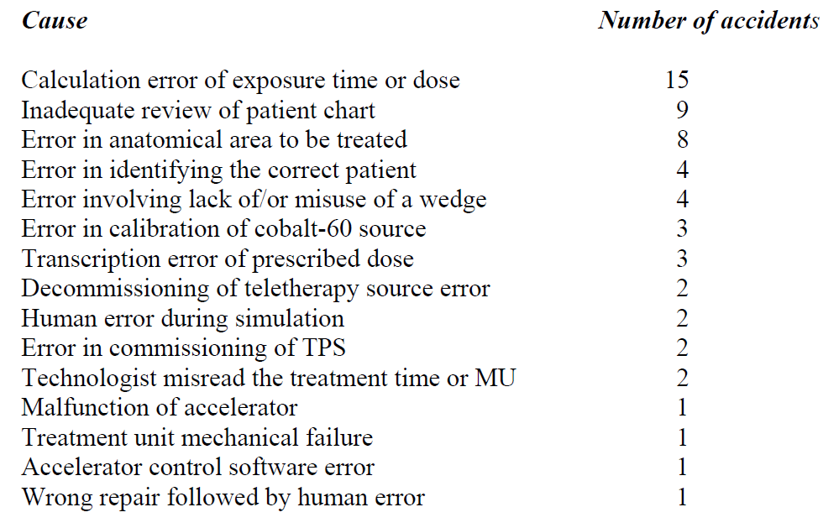
Lessons learned from accidental exposures in radiotherapy
IAEA (2000)

Slide 56
Tema 4
Control de calidad de aceleradores lineares en radioterapia
Control de calidad del acelerador lineal y sus componentes principales
Control de calidad del sistema de cálculo de dosis para aceleradores lineales
XII Mexican Symposium on Medical Physics, HARAO, Oaxaca Mexico, 16-18 Marzo 2012

Slide 57
Daily LINAC Tests
Tolerance and Action Levels are specified in millimeters unless otherwise stated

Slide 58
Daily LINAC Tests
DL1-7
The configuration of these tests will depend on the design of the facility and equipment. Safety is the concern and tests should be designed accordingly. As a minimum, manufacturer’s recommendations and applicable regulations must be followed.
DL8
Alignment of crosswires and appropriate lasers for collimator angle 0°, gantry angles 0°, 90° and 270° at an SSD of SAD-10 cm
DL9
Gantry angle 0° and at the isocentre
DL10
Gantry angle 0° and at the isocentre

Slide 59
Daily LINAC Tests
DL11
Gantry angle 0°, 100cm SAD, field sizes of 10x10 and 20x20 cm². Tolerances and Action Levels apply to each edge of a rectangular field.
DL12
All energies in use on the particular treatment day. Standard local
geometry.
DL13
“Dynamic wedge factors” for a representative set of soft wedges in use on a particular treatment day must be verified. Standards are relative to open beam outputs.
DL14
All energies in use on the particular treatment day. Standard local
geometry.

Slide 60
Tolerance and Action Levels are specified in millimeters unless otherwise stated

Slide 61
Monthly LINAC Tests
ML13
Using a dosimetry system calibrated against the local secondary standard the output of all available beams is checked against yearly reference dosimetry.
ML14
Measurements at two depths in an appropriate phantom serve to confirm that depth dose has not changed since commissioning the unit. Tolerances and Action Levels are specified in % for photon beams and mm for electron beams. Clinically relevant depths are used for these measurements
ML15,16
Flatness and symmetry, defined according to the protocol specified in the initial purchase document, are compared with those measured at acceptance. A single, convenient gantry angle may be chosen.

Slide 62
Annual LINAC Tests
Tolerance and Action Levels are specified in millimeters unless otherwise stated

Slide 63
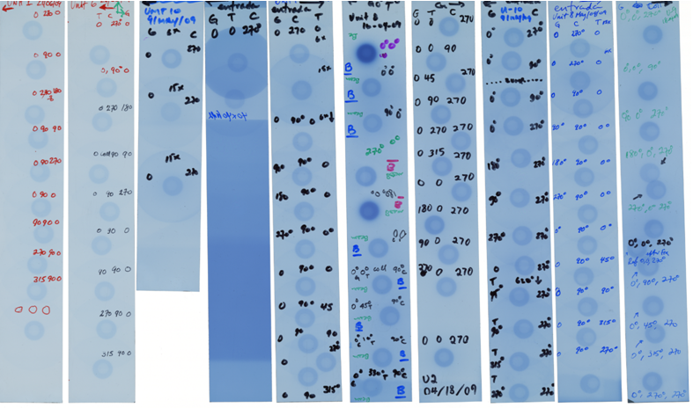
Reference ball
Winston-Lutz films
Collimated field

Slide 64
TG-142 vs Canadian standard : a head-to-head comparison of quality control guidelines for IMRT medical linear accelerators
E. Ghasroddashti, C. Kirkby^{a)}
P. Dunscombe
Interactions 57 (2011) 20 -23
Concluding Remarks
Ultimately a departmental Quality Assurance committee will integrate published standards along with the experience, knowledge base and specialized understanding of radiation therapy of its members, to create and maintain an effective quality control program relevant to the needs of its specific facility.

Slide 65
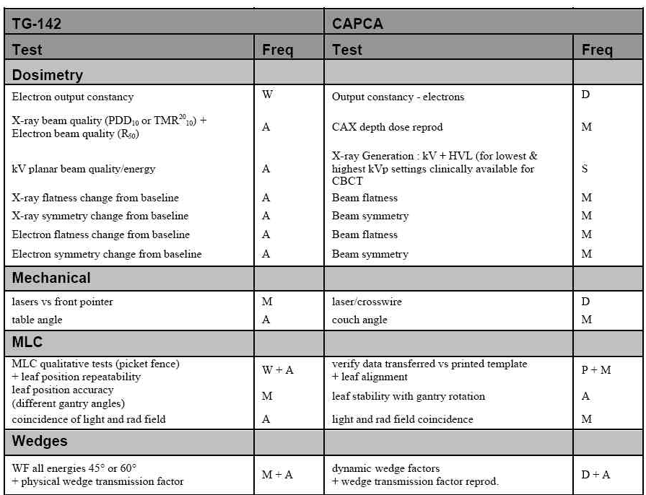

Slide 66
Tema 4
Control de calidad de aceleradores lineares en radioterapia
Control de calidad del acelerador lineal y sus componentes principales
Control de calidad del sistema de cálculo de dosis para aceleradores lineales
XII Mexican Symposium on Medical Physics, HARAO, Oaxaca Mexico, 16-18 Marzo 2012

Slide 67
Recommendations for Treatment Planning System verification
Van Dyk et al. IJROBP 1993, 26, 261-273
Major sources of uncertainty:
1 Measured data including beam, patient and CT
2 Data entry, for example, due to the digitizer
3 Data output, could be related to grid size
4 Algorithm inaccuracy

Slide 68
Recommendations for System verification
Van Dyk et al. IJROBP 1993, 26, 261-273
Comparison of predicted with measured relative doses is suggested for four dose regions and three sets of conditions:
Dose regions: central ray;
high dose/low dose gradient;
high dose gradient;
low dose/low dose gradient
Conditions: homogenous phantom/regular fields
inhomogeneous situations
all complexities included

Slide 69
Recommendations for System verification
Van Dyk et al. IJROBP 1993, 26, 261-273
Comparison of predicted with measured doses is suggested for four dose regions and three sets of conditions:
simple intermediate complex
central ray; 2% 3%
high dose/low dose gradient; 3% 4%
high dose gradient; 4mm 4 mm
low dose/low dose gradient; 3% 4%

Slide 70
Recommendations for system verification
Van Dyk et al. IJROBP 1993, 26, 261-273
Van Dyk and colleagues also make recommendations on:
1. Conditions for verification scans
2. Conditions for MU calculation verification
3. Reproducibility tests
4. Patient specific checks

Slide 71
Recommendations for System verification
Venselaar et al. Radiotherapy and Oncology 2001, 60, 191-201
Proposed values of the tolerances
Tolerance Simple Intermediat Complex
d1 (CA; high dose/low dose gradient) 2% 3% 4%
d2 (Build-up;penumbra;high dose & gradient) 2mm/10% 3mm/15% 3mm/15%
d3 (Central beam;high dose/low gradient) 3% 3% 4%
d4 (Outside beam;low dose and gradient) 3%(30%) 4%(40%) 5%(50%)
RW₅₀ (Radiological width) 2mm/1% 2mm/1% 2mm/1%
d ₅₀₋₉₀ (Beam fringe) 2mm 2mm 2mm

Slide 72
Recommendations for System verification
Venselaar et al. Radiotherapy and Oncology 2001, 60, 191-201
d3
d1
d₅₀₋₉₀
d2
RW₅₀
d4
d2

Slide 73
Recommendations for system verification
Venselaar et al. Radiotherapy and Oncology 2001, 60, 191-201
A few quotes from Venselaar paper:
“In case a TPS fails to meet the tolerances……restrict the clinical use to geometries that passed the test”
“Why is less accuracy required, for instance, for wedged beams?”
“(the criteria of acceptability) are based on what is realistically achievable with modern systems”
“Performance standards for treatment planning systems should thus ultimately converge to a criterion of 2% or 2mm for all situations”

Slide 74
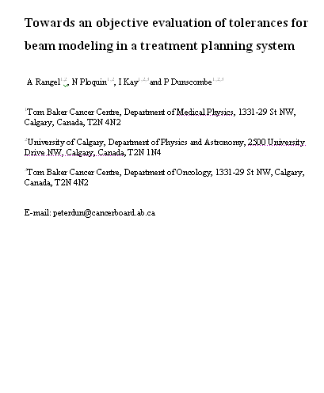
Objective tolerances for beam modeling
To explore the dosimetric impact of limitations in photon beam modeling accuracy on complex 3D clinical treatment plans
With thanks to Alejandra Rangel Ph.D.
Notes:
The idea behind this study was to answer questions such as of how accurate a model has to be in order to be adequate for a TPS?.
And whether the current tolerances are consistent.

Slide 75
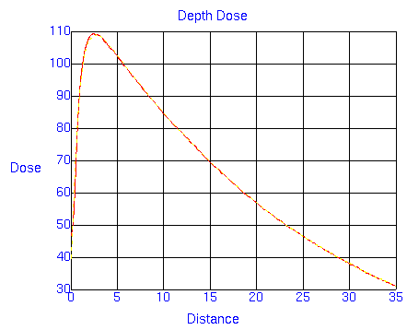
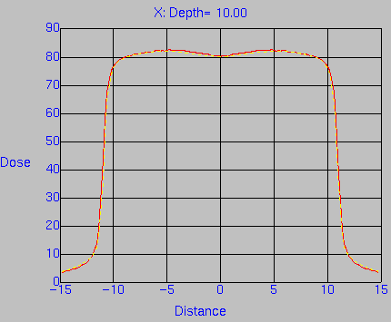
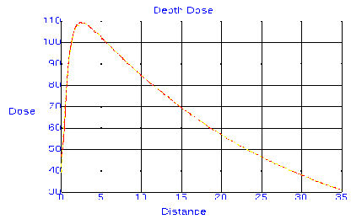
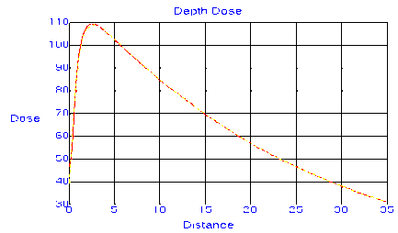

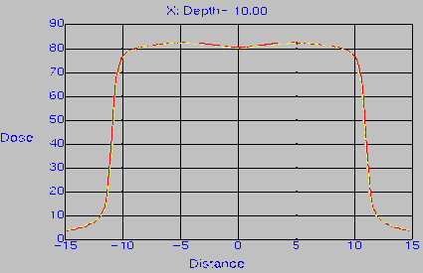
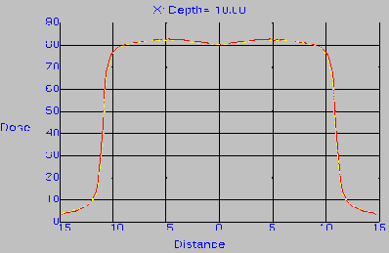
The beam models
XII Mexican Symposium on Medical Physics, HARAO, Oaxaca Mexico, 16-18 Marzo 2012
2 Re(6 & 15 MV)
12 sets of generated deviated profiles (each set has 6 models which produces deviations in 1 specific region of the dose profiles)
δ2 δ1
δ1
δ2
δ3
δ4
δ5
δ6
6 models (for δ1)
6 sets
(6MV)
6 models (for δ2)
12 sets
δ3
δ6
δ5
δ4
6 sets
(15MV)
Notes:
We designed a model that generates dose profiles very close to Varian’s “Golden Data” and took this model as our reference.
The reference model was then perturbed in a control manner to develop a series of test models which generate dose profiles deviated by known amounts in specific regions.
The regions of the dose profiles are: the descending DD, the Build-up, the horns of the profile, the tail , the penumbra and the field width.
We have 12 sets of beam models, 6 sets are intended for a 6MV and the rest for a 15 MV beam.
The 6 sets correspond to the 6 regions previously mentioned
And for each region there are 6 models corresponding to different deviations

Slide 76
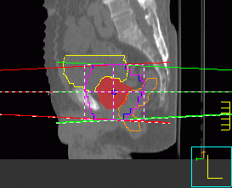
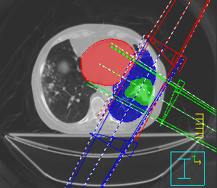
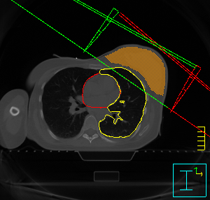
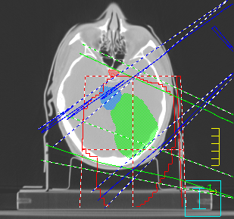
3DCRT plans
4-field conformal plan
(15 MV beams)
3-4 field conformal plan
(6 MV beams)
2-field tangential plan
(6 MV beams)
3-8 field conformal plan
(6 MV beams)
Notes:
We evaluated the performance of the test models in 2 treatment planning sites:
A total of 8 prostate and 7 breast plans were used.
The characteristics of the plans are
4 parallel opposed beams and the use of the MLC.
2 tangent beams and the use of the dynamic wedge
The OAR considered are
the bladder and the rectum.
the respective Lung and the heart

Slide 77
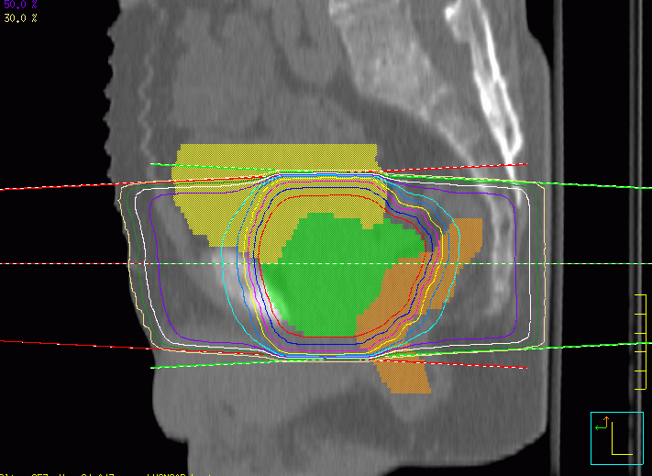
Prostate Results
Notes:
Now I’m going to show you the results using prostate plans…
The data for the 8 clinical plans were averaged to display the sensitivity of the calculated EUD to the degree of perturbation in the various regions. The error bars represent + or – 1 standard deviation of the 8 plans.
The colors of the lines refer to the color of the perturbed region for that case and are labelled in the graph.
For example for d1 (depth dose) in green a 1% deviation on the x axis corresponds to approximately 0.7% change in EUD of the CTV
The general impressions for the CTV, bladder and rectum are:
BU deviations in yellow have poor effect in the dose given to all structures (what makes sense for prostate plans)
tail deviations in blue are affecting more the OAR than the CTV as expected for a good target coverage, the CTV is completely inside the field therefore what occurs outside the field will only affect the OAR.
the descending DD in green and the horns in red are the most important regions affecting all 3 structures. The higher iso-dose lines will be defined by these regions, thereby changes in these regions will be more significant

Slide 78
Prostate Results
Notes:
Now I’m going to show you the results using prostate plans…
The data for the 8 clinical plans were averaged to display the sensitivity of the calculated EUD to the degree of perturbation in the various regions. The error bars represent + or – 1 standard deviation of the 8 plans.
The colors of the lines refer to the color of the perturbed region for that case and are labelled in the graph.
For example for d1 (depth dose) in green a 1% deviation on the x axis corresponds to approximately 0.7% change in EUD of the CTV
The general impressions for the CTV, bladder and rectum are:
BU deviations in yellow have poor effect in the dose given to all structures (what makes sense for prostate plans)
tail deviations in blue are affecting more the OAR than the CTV as expected for a good target coverage, the CTV is completely inside the field therefore what occurs outside the field will only affect the OAR.
the descending DD in green and the horns in red are the most important regions affecting all 3 structures. The higher iso-dose lines will be defined by these regions, thereby changes in these regions will be more significant

Slide 79
Venselaar’s tolerances¹
Tolerances for photon beam modeling
Clinical outcome
1 Venselaar et al, "Tolerances for the accuracy in photon beam dose calculation of treatment planning systems," Radiother. Oncol. 60, 191-201 (2001).

Slide 80
Objective tolerances
Tolerances for photon beam modeling
Clinical outcome
Notes:
setting tolerances based on predicted clinical outcome, if possible, is a more logical approach than setting tolerances based on what is routinely achievable

Slide 81
Conclusions
δ1 (Descending Depth Dose) and δ3 (Horns) have the greatest impact on targets
δ6 (Field Width) has the greatest impact on OARs
Notes:
Now that we have a way to quantify the effects of photon beam model deviations we can tell the regions that require more attention.
δ1(Depth dose) and δ3 (horns) which noticeably affect all considered structures
δ6(Field Width) which noticeably affects the OARs in both treatment sites.
The variability of EUD regarding deviations of the beam model does depend on anatomical site. But when looking at the individual effect of the accepted tolerances we still found a level of consitency in terms of…

Slide 82
Tema 5
Control de calidad de sistemas de planeación (3D)
a. Control de calidad en sistemas de planeación-3D (Rayos X y haces de Electrones)
b. IMRT

Slide 83
Implementation of Quality Control of Radiation Treatment Planning Systems (TPS)

Slide 84
Objectives
Main components of TPS
Review reports on QA of TPS
Describe implementation of QC based on CAPCA

Slide 85
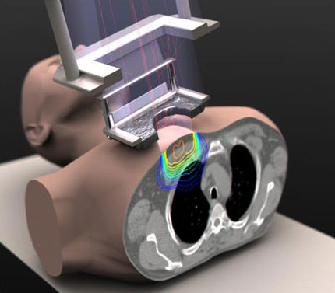
Introduction
Modern TPS
  Increased use of patient images
  Various imaging modalities
  Enhanced 3D-display
  More sophisticated dose calculation algorithms
    Inverse planning
  More complex treatment planning evaluation tools
    DVH
  Dynamic delivery
    Wedges
    IMRT

Slide 86
QA of Treatment Planning Systems
Issues to address
  Hardware
  Software
    4D, IMRT, Optimization, plan evaluation
  Networking
    Imaging devices
    Dosimetry devices

Slide 87
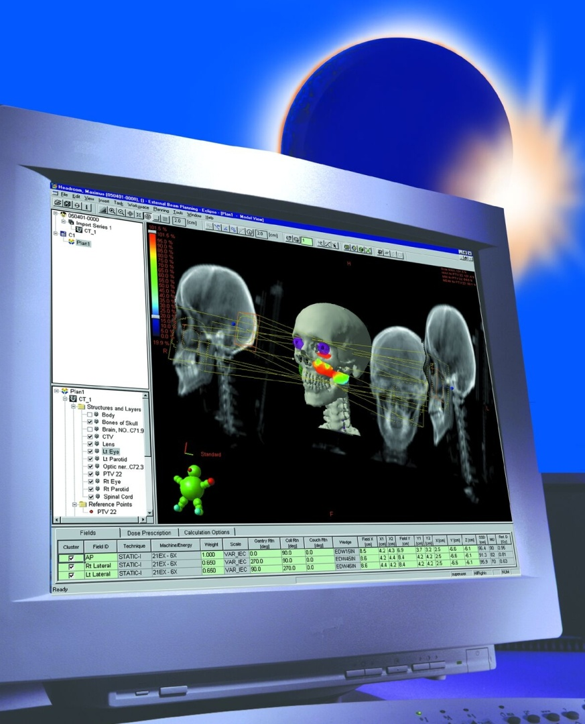
Main Components of TPS
  Hardware
    CPU
    Hard disc
    High resolution graphics
    High resolution monitor
    Digitizer
    Printer
    Backup storage facility

Slide 88
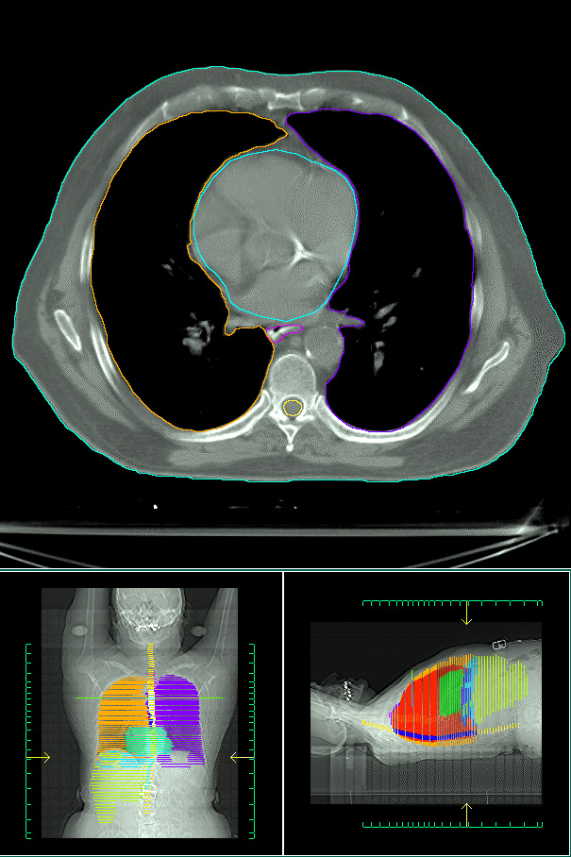
Main Components of TPS
  Software (Complex parts of a planning system)
    Dose-calculation algorithm code
    Programs used to manipulate 3D graphic displays of the patient, beam geometry, and dose
    optimization engine

Slide 89
TPS QA Protocols
Med. Phys. 25 , 1998

Slide 90
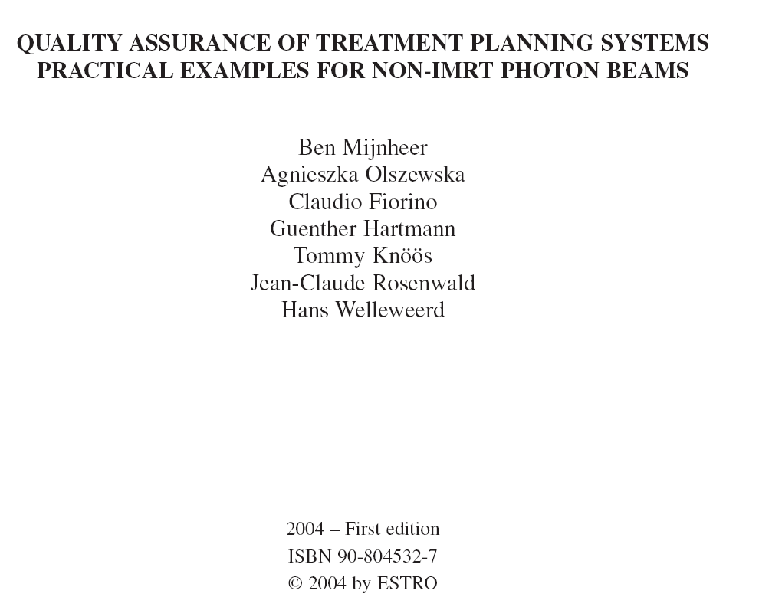
QA Protocols
www.estroweb.org/estro/index.cfm

Slide 91
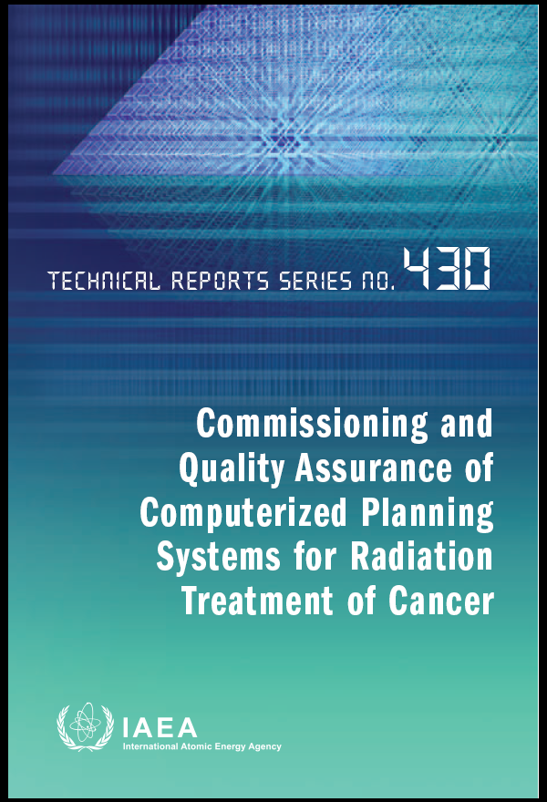
QA Protocols

Slide 92
TPS QA Components
When developing QA for the TPS, the QA components that must be addressed are the following:
1. acceptance tests
2. commissioning tests
3. routine QA (reproducibility) tests

Slide 93
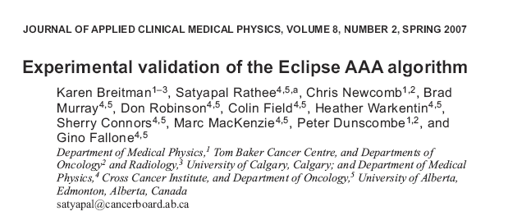
Acceptance test & commissioning of the Eclipse TPS at the TBCC

Slide 94
IAEA TRS 430
1. INTRODUCTION
2. CLINICAL TREATMENT PLANNING PROCESS
3. DESCRIPTION OF RADIATION TREATMENTPLANNING SYSTEMS
4. ALGORITHMS USED IN
RADIATION TREATMENT PLANNING
5. QUALITY ASSESSMENT
6. QUALITY ASSURANCE MANAGEMENT
7. PURCHASE PROCESS
8. ACCEPTANCE TESTING
9. COMMISSIONING
10. PERIODIC QUALITY ASSURANCE

Slide 95
QC based on IAEA TRS-430
PS=Patient specific , W=weekly,
M= Monthly, Q=Quarterly
A= Annually= Software or Hardware Upgrade
IAEA-430, Table-61

Slide 96
CAPCA TPS QC

Slide 97
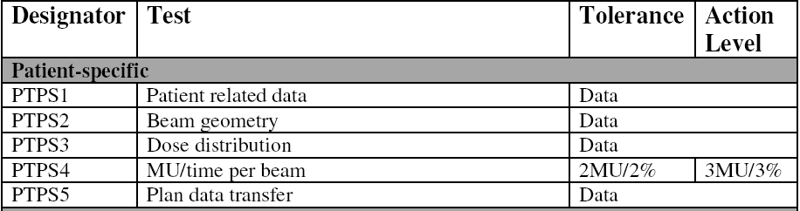
Patient-Specific Tests

Slide 98
Patient-Specific Tests
’’ Every treatment plan must be checked by a person different from the original treatment planner. The independent check should be performed by a radiation oncology physicist .In some cases, this check may be performed by a senior treatment planner.’’
(IAEA 430)- page 222
(IAEA 430)- Fig.16

Slide 99
Patient-Specific (PTPS1, PTPS2, PTPS3)
Check list for patient treatment plan:
Anatomical and contour data are current and for the correct patient; correct orientation; target and OAR contours look reasonable.
Wedges correctly oriented; compensators and bolus included as
appropriate; MLC correctly oriented; plan normalization
point in an appropriate position.
Dose distribution looks reasonable for the beam geometry; beam configuration achievable; plan objectives and constraints met as closely as possible. Clearly the plan has to be consistent with the prescription and receive approval by the Radiation Oncologist.

Slide 100
Patient-Specific (PTPS4, PTPS5)
Independent check of MU or time per beam either manually or by an independent computer program. Local tolerance and action levels may need to be developed for complex geometries such as IMRT, thoracic and tangential breast irradiation.
Prior to the first treatment, the treatment machine settings must be compared with those used to generate the dose distribution.

Slide 101
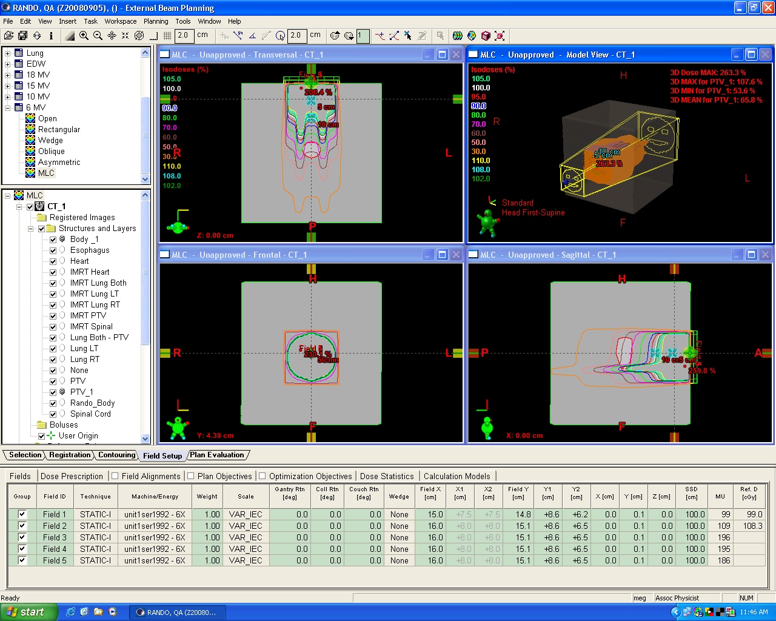
MU check test plans (PTPS4)
28 different plans have designed to cover most aspect of software capabilities. For example: Symmetric and asymmetric fields, MLC, dynamic wedges,…

Slide 102
Patient-Specific documents
List of patient specific procedure and policy documents available at TBCC:
Eclipse Plan QA Check List
Guidelines for Monitor Unit Calculations & Second Checks for Electron Beams in Eclipse
IMRT QC Delivery in ARIA
Physics IMRT Plan checklist for Eclipse 2008
plan checking policy
TP-19 Non IMRT Treatment Plan Checks by Physicist
TP-25 Guidelines for Monitor Unit Calcs & Second Checks for Electron Beams
TP-29 Patient Transfer Guidelines
Treatment Plan Checks-Standard Practice-External Beam Plans
Available: J:\USERS\Mehran\TPS QA\Draft

Slide 103
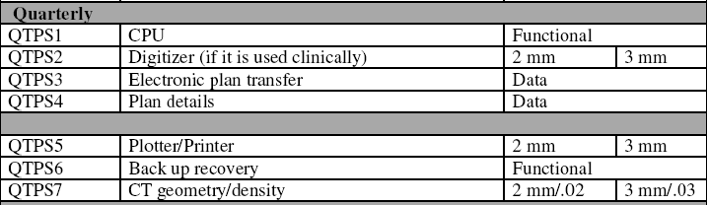
Quarterly Tests

Slide 104
Quarterly (QTPS1) - CPU
To check that the CPU, memory, file systems and operating system are functioning optimally.
The system should be checked if error message is displayed during rebooting process.
Using Windows log file to track any error or message when system reboot.

Slide 105
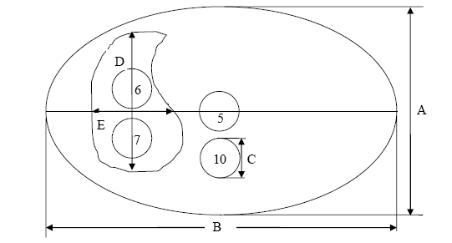
Quarterly (QTPS2)- Digitizer
To check that the digitizer sensitivity has not drifted. A known contour has been digitized accurately.

Slide 106
Quarterly (QTPS3)- Electronic Plan Transfer
Using a standard set of clinical plans covering a range of treatment configurations , confirm that the data are accurately transferred from the TPS to the therapy machine.
Five different plans have designed to cover a different range of parameters.

Slide 107
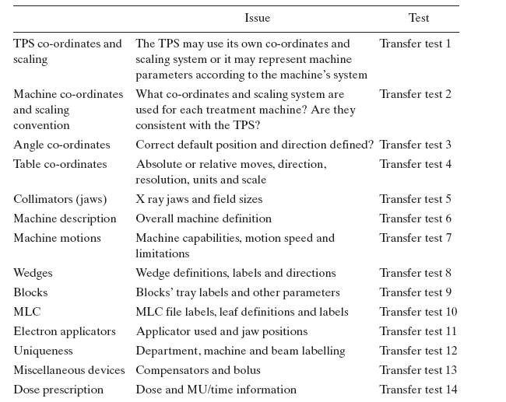
Issues to address for Electronic Plan Transfer

Slide 108
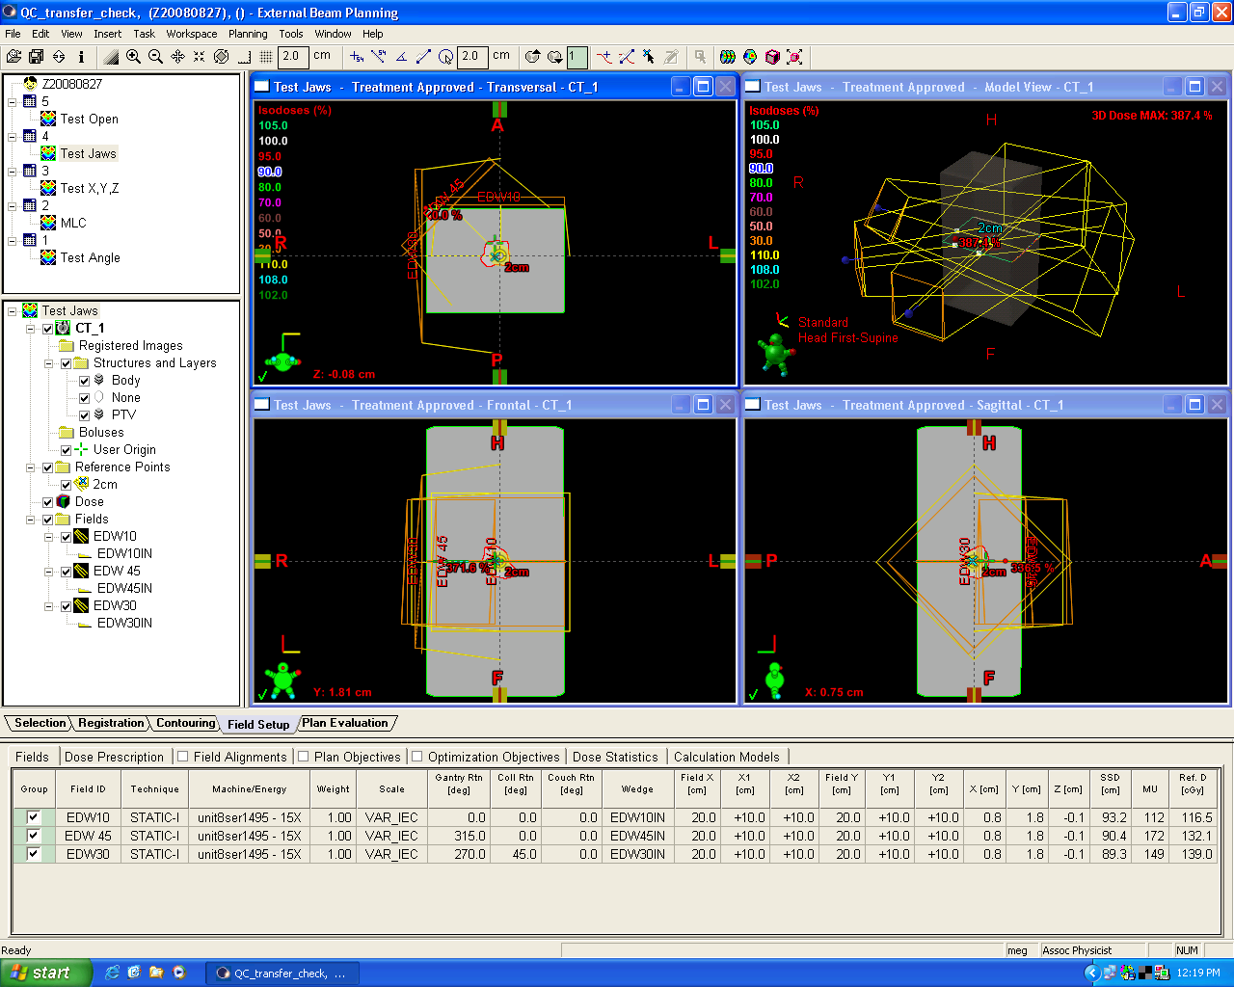
Electronic Plan Transfer tests

Slide 109
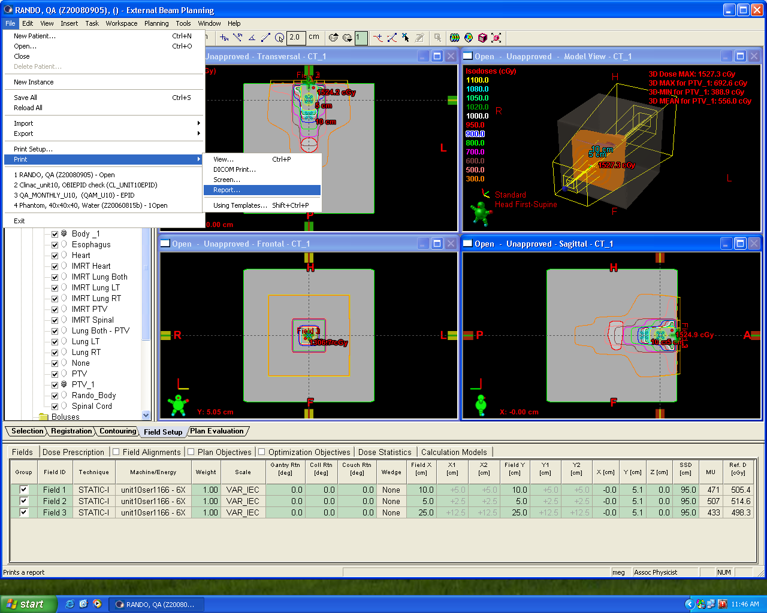
Quarterly (QTPS4) – Plan details
To check that the plan information shown on hard copy has not changed.
To check isocentre co-ordinates, details of field size, wedges, etc., are printed exactly as before.

Slide 110
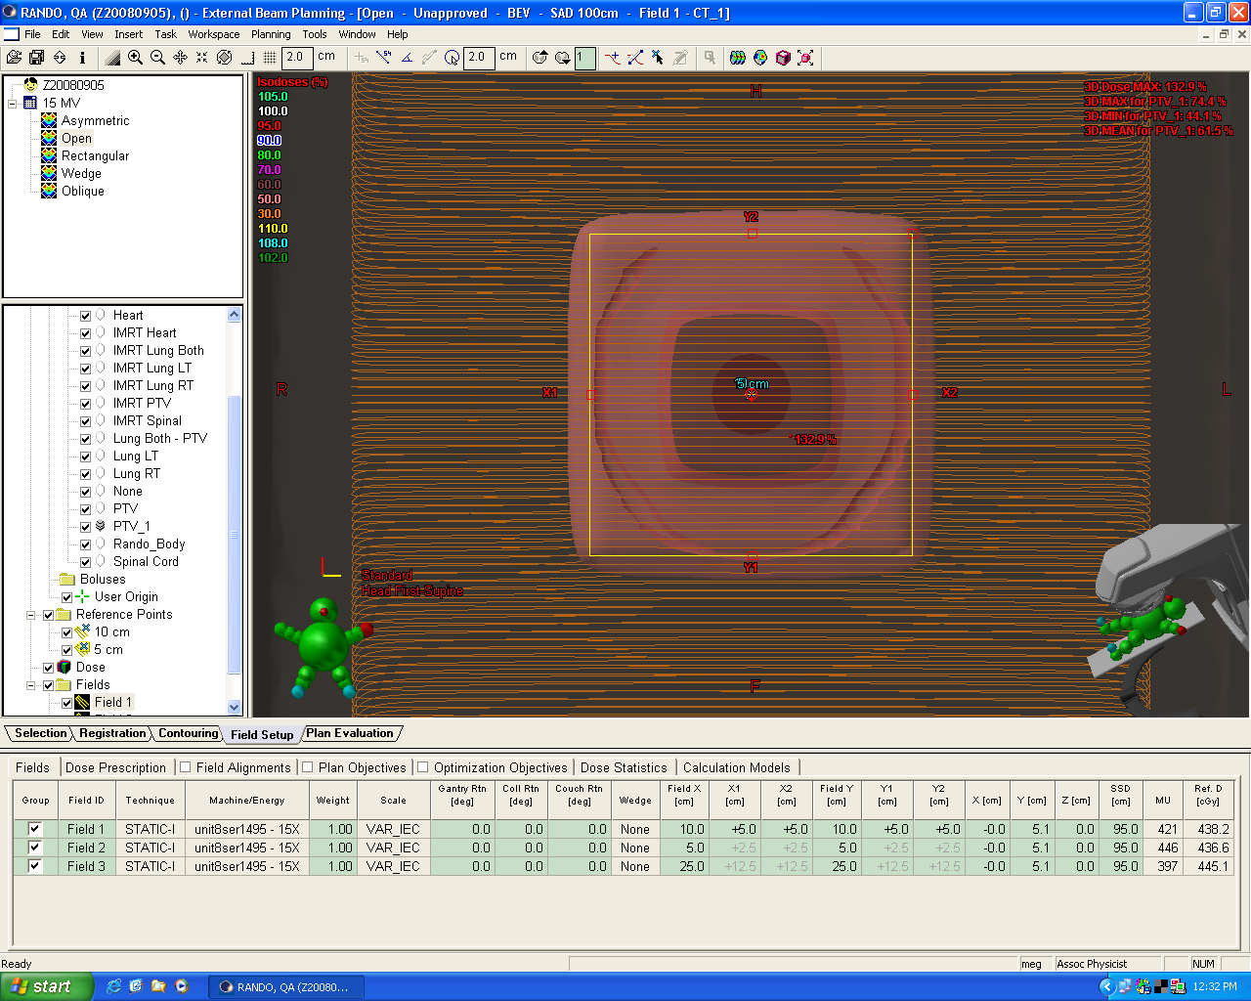
Quarterly (QTPS5) – Printer
Check the dimensions on the print out against the plan plots.

Slide 111
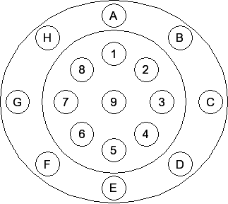
Quarterly (CT geometry/density test)
To check that the CT geometry and the relationship between CT number and density has not changed.
(CIRS Model 62 Electron Density Phantom)

Slide 112
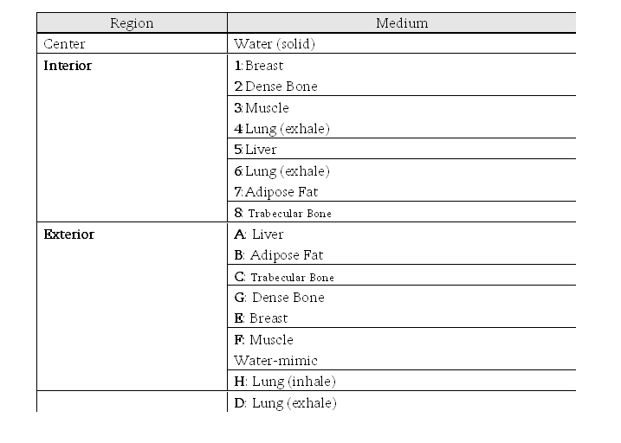
Quarterly (CT geometry/density test)
Protocol used : (Oncobody Abdomen): 120 kVp, Collimation 16x1.5, FOV=350 mm, Standard Filter (B), Standard resolution, slice thickness = 3mm.

Slide 113
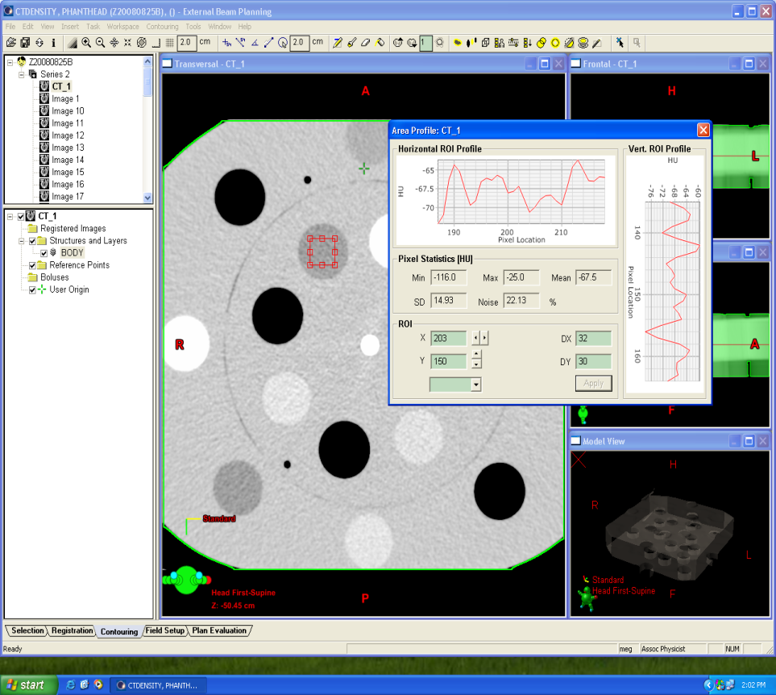
Quarterly (CT geometry/density test)
2 mm / 0.02 or +/- 20 HU

Slide 114
Revalidation tests
Check the constancy of external beam dose calculations using a standard set of clinical plans covering a range of geometries.

Slide 115
Revalidation tests
Test case 1: Water phantom, 100-cm SSD, open square field
Test case 2: Water phantom, extended SSD 125 cm, open square field
Test case 3: Water phantom, 100-cm SSD, open rectangular field
Test case 4: Water phantom, 100-cm SSD, wedged square fields
Test case 5: Water phantom, open square field, isocentric setup
Test case 6: Water phantom, 100-cm SSD, open square field, oblique
incidence
Test case 7: Water phantom, 100-cm SSD, asymmetric jaws .half beam
and 45° wedge
Test case 8: Water phantom, 100-cm SSD, wedged field, oblique
incidence
Test case 9: Water phantom, 100-cm SSD, MLC field
Test case 10: Heterogeneous medium (Rando phantom)

Slide 116
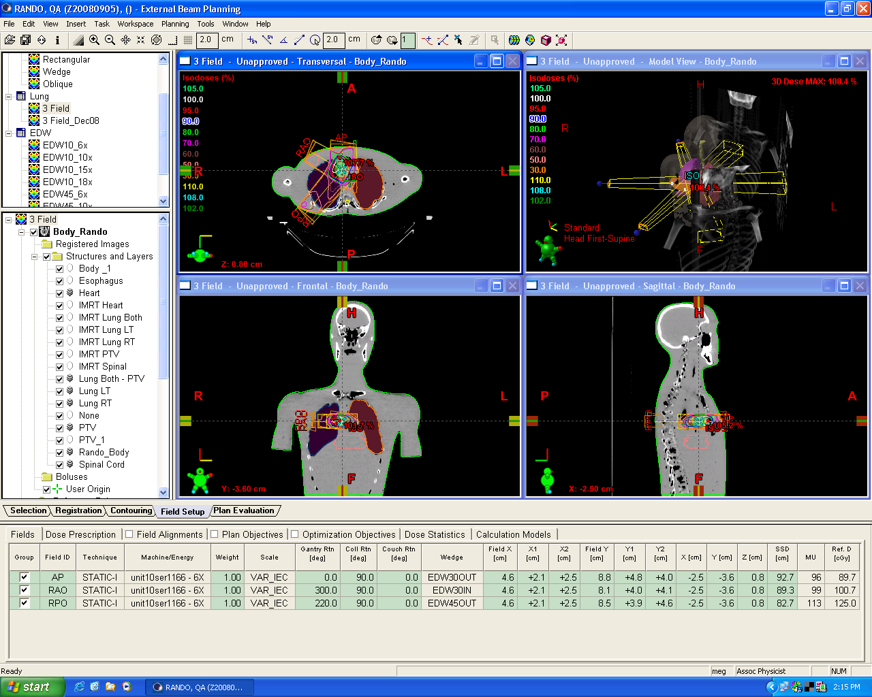
Revalidation tests

Slide 117
Revalidation tests
Check list for Revalidation test:
Point dose calculations
Beam profile along central axis
dose distributions on the axial view
dose distributions on the coronal view
dose distributions on the saggital view
Calculated monitor for each field
Dose-Volume histogram check
  DVH plots
  calculated maximum doses
  calculated mean doses
  calculated median doses
  calculated minimum doses

Slide 118


Revalidation tests

Slide 119
Remaining challenges
The QC for TPS as proposed by CPQR guidelines didn’t address for Brachytherapy dose calculation software, IMRT or VMAT special calculations.
Performing this QC for Monthly based is about 4 hours
Quarterly Tests require 8 hours
Annual Tests (review included) takes ~16 hours

Slide 120
Aknowdledgments
Mehran Goharian, Ph.D
Alejandra Rangel Baltazar , Ph. D
Ian Nygren, MSc
Tyler Mayer, Ph.D
Rao Khan, Ph.D
Essi. Ghasroddashti, Ph.D
Charles Kirkby, Ph.D
Peter Dunscombe, Ph.D

Slide 121
Tema 6
Nuevas tendencias en el Control de Calidad en Radioterapia
FEMA (Failure Mode and Effects Analysis) y su uso como herramienta para el desarrollo de un programa efectivo de Garantía de Calidad en Radioterapia
Control “objetivo” de calidad en radioterapia

Slide 122

Priorizing Quality Control
Objective Approach
With thanks to Alejandra Rangel Ph.D.
We need to identify and resource those activities that contribute most to maximizing quality and minimizing error.

Slide 123
Priorizing Quality Control
AAPM’s TG100
Method for Evaluating QA Needs in RT
Subjective Approach
Identify a structured systematic QA program approach that balances patient safety and quality versus resources commonly available and strike a good balance between prescriptiveness and flexibility.

Slide 124
Priorizing Quality Control
Objective Approach
With thanks to Alejandra Rangel Ph.D.
We need to identify and resource those activities that contribute most to maximizing quality and minimizing error.

Slide 125
The Effect of Performance Deviations on the Prostate CTV
Bars = Average ΔEUD per course of treatment
Error bars = 1 Std dev for n = 7
(Medical Physics 36 (2008) 2513-2518)
Notes:
125
X axis
Y axis
Green bars
Red bars
Error bars
All tolerance levels are within 2% but in different amounts
action levels are not consistent in terms of the effects of our outcome surrogate.

Slide 126
MLC Quality Control Standards
The 2 most common IMRT treatment sites at the TBCC were studied.
In-house software incorporated random and systematic errors in the position of the MLC leaves.
Plans were re-computed.
7 Prostate IMRT
7 Head & Neck IMRT
Medical Physics 36 (2009) 3304-3309
Notes:
126
We have programmed an algorithm that reads MLC files and perturbed the leaves position so as to simulate MLC malfunctioning

Slide 127
MLC Quality Control Standards
H&N plans showed greater sensitivity to leaf position errors than prostate plans
Random errors of up to 2 mm showed negligible effects
The dosimetric effects of systematic errors were found to be linearly related to the size of the error
Dosimetric outcome
Tolerances for MLCs
Random errors | mm
Systematic errors | mm
Target: 2% ΔEUD
OARs: 2Gy ΔEUD
2
0.5

Slide 128
Linac Quality Control Standards
7 CT data sets in 4 anatomical sites
Simulate Linac performance deviations at the tolerance and action levels of CAPCA
Calculate Equivalent Uniform Doses of targets and organs at risk
Notes:
We simulated Linac performance deviations in 8 characteristics at the tolerance and action levels stated by CAPCA
We used the info of 7 CT data sets each for 4 different treatment sites that were previously approved by the Oncologist
The way deviation were simulated was by direct perturbation of the reference plans or by perturbation of the beam model.
For example the field size was varied trough modification in the position of the MLC and Jaws with respect to the reference configuration.
The output was varied trough modification of the dose per monitor unit value in the physics tool of the treatment planning system.
We created close to 900 test plans which are similar to the reference plans but they include deviation in each of the 8 at the 2 levels and in both directions.

Slide 129
Linac Quality Control Standards
CAPCA Tolerance Levels are shown to maintain average EUD deviations to within 2% and 2 Gy.
However they show markedly different effects over the range of 2% or 2 Gy.

Slide 130
Priorizing Quality Control
AAPM’s TG100
Method for Evaluating QA Needs in RT
Subjective Approach
Identify a structured systematic QA program approach that balances patient safety and quality versus resources commonly available and strike a good balance between prescriptiveness and flexibility.

Slide 131
AAPM’s TG100
Current Projects:
A Failure Modes and Effects Analysis (FEMA) of the IMRT and HDR Brachytherapy processes.

Slide 132
AAPM’s TG100

Slide 133

TG-100 Draft HDR BTx FMEA
A total of 98 Failure Modes were identified

Slide 134
Muchas gracias

